Slide 1
NETWORK ATTACKS
Dr. Arshad Farhad

Slide 2
Lecture Content:
What is a network attack?
  Basic types of attacks
  Endpoint attacks
  Malware attacks
Zero-Day Exploit?
  Zero-day exploit, vulnerability, and attack
  Working of Zero-day attack.
Types of Network Attacks
  Unauthorized access, DDoS, MiTM, SQL injection, Privilege escalation, and Insider threat

Slide 3
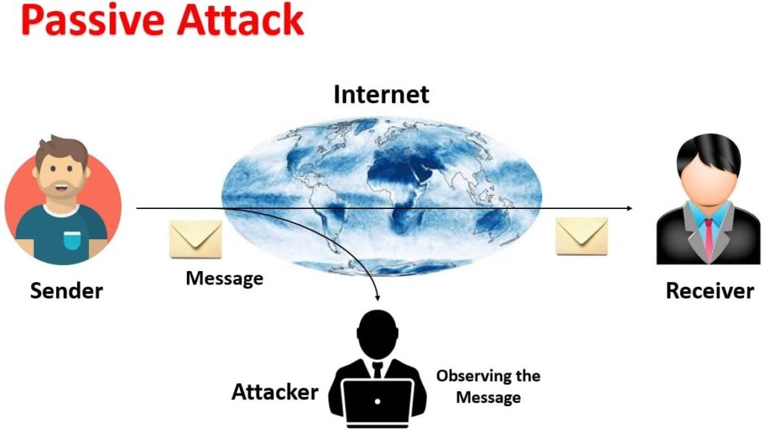
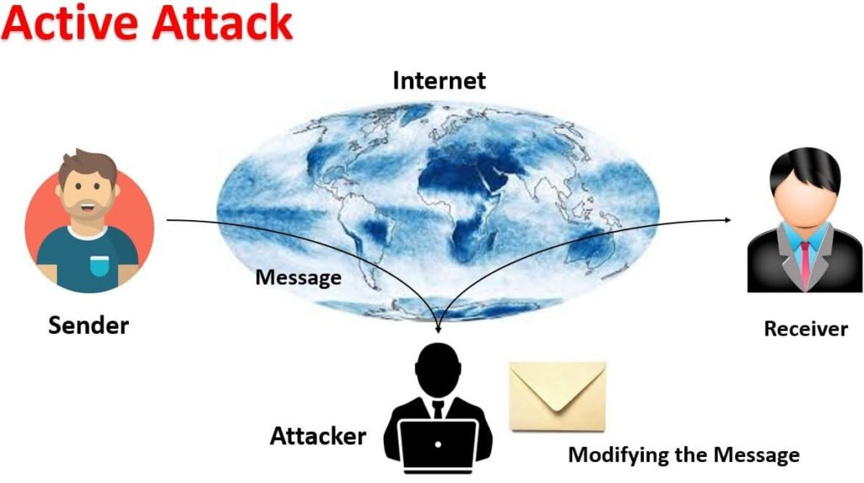
What is Network Attack?
A network attack attempts to gain unauthorized access to an organization’s network, steal data, or perform other malicious activity. There are two main types of network attacks:
Passive: Attackers gain access to a network and can monitor or steal sensitive information without changing the data, leaving it intact.
Active: Attackers gain unauthorized access and modify data, either deleting, encrypting or otherwise harming it.

Slide 4

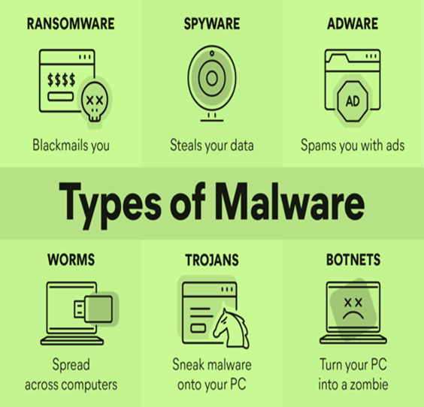


Other types of attacks:
Endpoint attacks—gaining unauthorized access to user devices, servers or other endpoints, typically compromising them by infecting them with malware.
Malware attacks—infecting IT resources with malware, allowing attackers to compromise systems, steal data and do damage. These also include ransomware attacks
  Trojan Horse
  Virus
  Worm

Slide 5
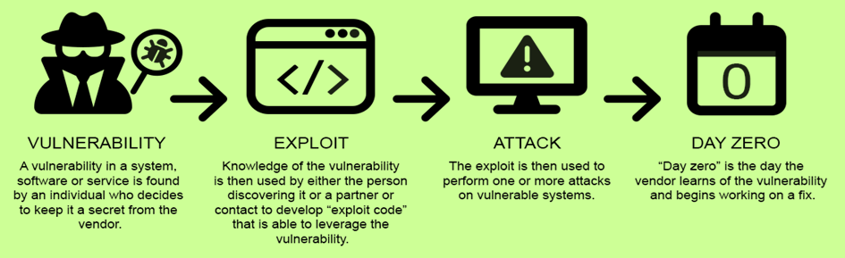
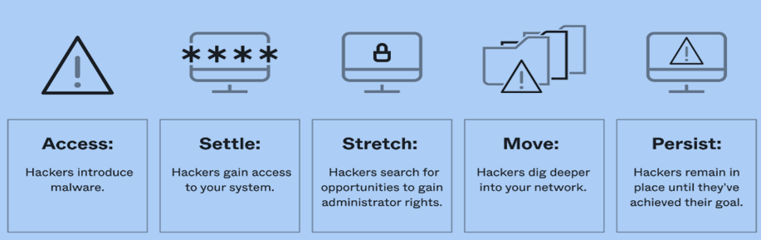
Other types of attacks:
Vulnerabilities, exploits and attacks—exploiting vulnerabilities in software used in the organization, to gain unauthorized access, compromise or sabotage systems.
Advanced persistent threats—these are complex multilayered threats, which include network attacks but also other attack types.

Slide 6

What Is a Zero-Day Exploit?
While businesses have always had many threats, cyber-attacks are increasingly worrying. A zero-day exploit is one of the severe malware threats
A zero-day attack is an attack that exploits a software vulnerability that is not known to the software vendor or its users.
Zero-day exploits have many names, including “zero-hour exploits” or “day0 exploits.”
After someone discovers a zero-day vulnerability, developers have zero days to fix the error before it becomes an urgent issue.
“Zero-day exploit” refers to the method hackers use to attack software.
“Zero-day vulnerability” refers to the undiscovered flaw in your system.
“Zero-day attack” refers to the action hackers take when they use the vulnerability to breach your system.

Slide 7
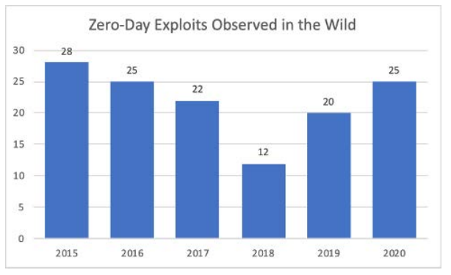
What Is a Zero-Day Exploit?
Cybercriminals: Criminal hackers with a financial motivation.
Hacktivists: People looking to hack into systems to further a political cause or agenda.
Corporate hackers: Hackers who are looking to learn information about a competitor.
For-profit hackers: People who find vulnerabilities to sell them to companies (but don’t intend to exploit the vulnerability themselves).
Google has at least 22
unforeseen attacks every year

Slide 8
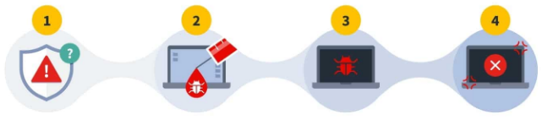
How a Zero Day Attack Works?
1
2
3
4
The developers create a system. This system contains a zero-day vulnerability that developers don’t know about (a security flaw exists).
1
After the system is live, the hacker (sometimes called a “threat actor” or “malicious actor”) discovers a vulnerability in the system (the hacker discovers and exploits it by malware injection).
2
3
The hacker writes and executes malicious code to exploit the vulnerability and breach your system (potentially resulting in data loss).
Either the public or developers notice a severe problem, and developers fix the problem with a patch (the developer detects the attack and has zero days to fix it).
4

Slide 9
Detecting and Responding to Zero-Day Attacks.
Home Work!

Slide 10
Zero-day attacks - Examples
2021: Chrome zero-day vulnerability
  In 2021, Google's Chrome suffered a series of zero-day threats, causing Chrome to issue updates. The vulnerability stemmed from a bug in the V8 JavaScript engine used in the web browse.
    https://chromereleases.googleblog.com/2021/04/stable-channel-update-for-desktop_20.html
2020: Zoom
  A vulnerability was found in the popular video conferencing platform. This zero-day attack example involved hackers accessing a user’s PC remotely if they were running an older version of Windows. If the target was an administrator, the hacker could control their machine and access all their files.
    https://www.darkreading.com/vulnerabilities-threats/zoom-patches-zero-day-vulnerability-in-windows-7
2020: Apple iOS
  Apple’s iOS is often described as the most secure of the major smartphone platforms. However, in 2020, it fell victim to at least two sets of iOS zero-day vulnerabilities, including a zero-day bug that allowed attackers to compromise iPhones remotely.

Slide 11
Zero-day attacks - Examples
2019: Microsoft Windows, Eastern Europe
  This attack focused on local escalation privileges, a vulnerable part of Microsoft Windows, and targeted government institutions in Eastern Europe. The zero-day exploit abused a local privilege vulnerability in Microsoft Windows to run arbitrary code and install applications and view and change the data on compromised applications. Once the attack was identified and reported to the Microsoft Security Response Center, a patch was developed and rolled out.
2017: Microsoft Word
  This zero-day exploit compromised personal bank accounts. Victims were people who unwittingly opened a malicious Word document. The document displayed a "load remote content" prompt, showing users a pop-up window that requested external access from another program. When victims clicked "yes," the document installed malware on their device, which was able to capture banking log-in credentials.

Slide 12
Zero-day attacks - Examples
Stuxnet
  Stuxnet is a computer worm originally aimed at Iran's nuclear facilities and has since mutated and spread to other industrial and energy-producing facilities.
  One of the most famous examples of a zero-day attack was Stuxnet. First discovered in 2010 but with roots that spread back to 2005, this malicious computer worm affected manufacturing computers running programmable logic controller (PLC) software.
  The primary target was Iran's uranium enrichment plants to disrupt the country's nuclear program.
  The worm infected the PLCs through vulnerabilities in Siemens Step7 software, causing the PLCs to carry out unexpected commands on assembly-line machinery.
  The story of Stuxnet was subsequently made into a documentary called Zero Days.

Slide 13

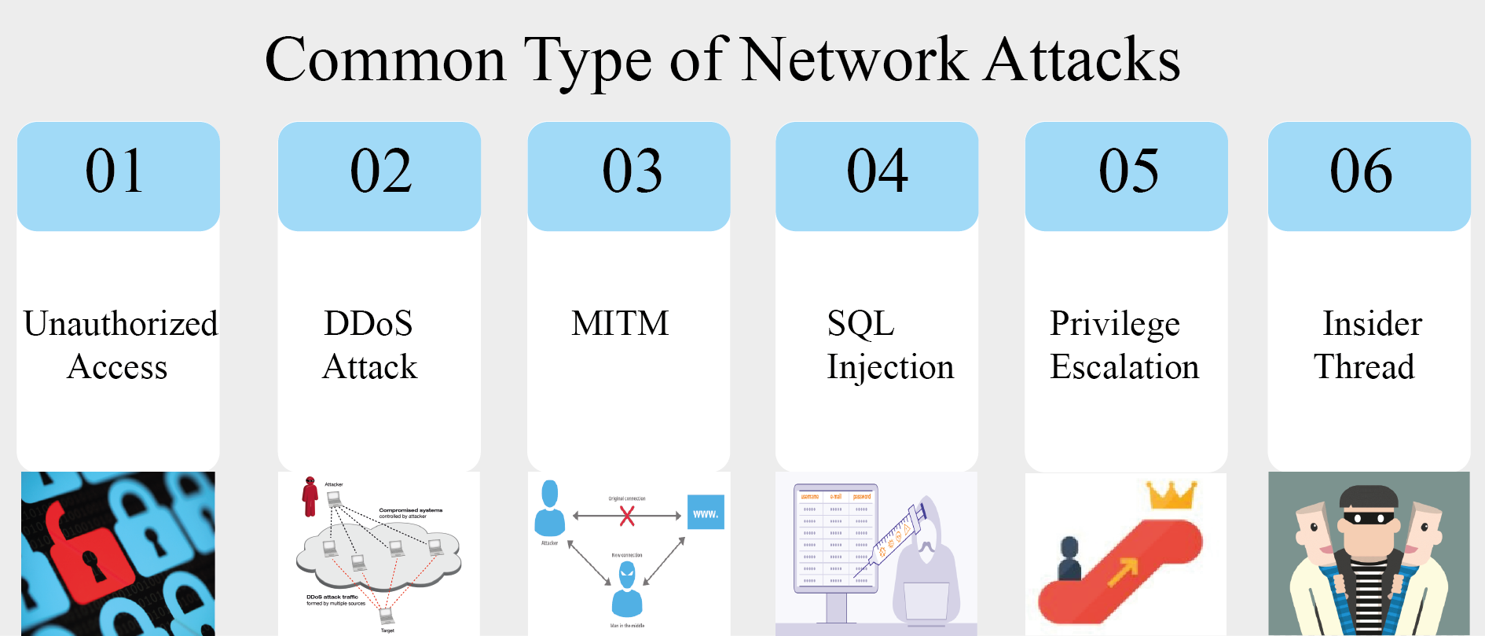

Types of Network Attacks?
Insider
Threat

Slide 14
Common Types of Network Attacks
Unauthorized access
Unauthorized access refers to attackers accessing a network without receiving permission. Among the causes of unauthorized access attacks are weak passwords, a lack of protection against social engineering, previously compromised accounts, and insider threats.
The best way to avoid these threats are:
Don’t open emails and attachments from suspicious sources
Use multi-factor authentication
Be wary of tempting offers
Keep your antivirus software updated
Baiting
Scareware
Pretexting
Phishing
Spear Phishing

Slide 15
Common Types of Network Attacks
Baiting is tricking people with something attractive to hack their computer, like leaving a fake USB stick.
Scareware makes false alerts to scare people into buying unnecessary software, such as a pop-up saying your computer has a virus.
Pretexting is pretending to be someone else to get information, like calling and pretending to be from a bank to trick someone into sharing their account details.
Phishing is using fake emails or websites to trick people into giving personal information, like sending an email that looks like it's from a bank asking for login details.
Baiting
Scareware
Pretexting
Phishing
Spear Phishing

Slide 16
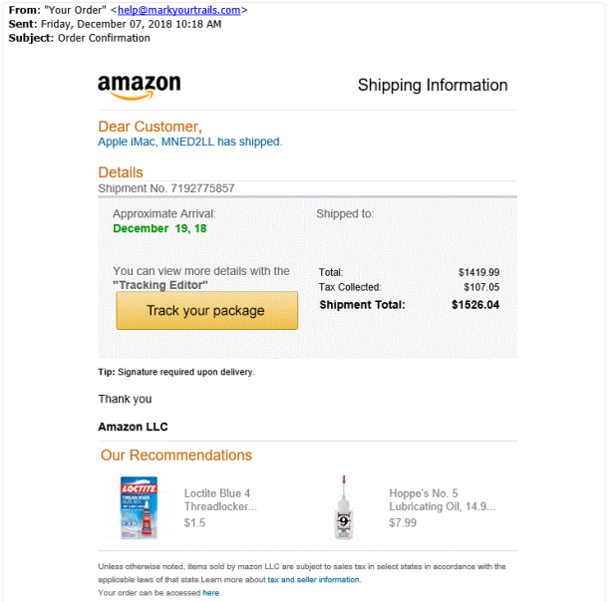
Phishing

Slide 17
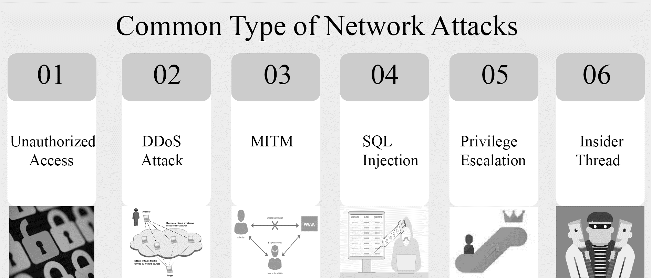
Types of Network Attacks?
Insider
Threat

Slide 18
Common Types of Network Attacks
Distributed Denial of Service (DDoS) attacks
Attackers build botnets, large fleets of compromised devices, and use them to direct false traffic at your network or servers. DDoS can occur at the network level, for example, by sending huge volumes of SYN/ACK packets, which can overwhelm a server, or at the application level, for example, by performing complex SQL queries that bring a database to its knees.
How to identify a DDoS attack
Suspicious amounts of traffic originating from a single IP address or IP range
A flood of traffic from users who share a single behavioral profile, such as device type, geolocation, or web browser version
An unexplained surge in requests to a single page or endpoint
Odd traffic patterns, such as spikes at odd hours of the day or practices that appear to be unnatural

Slide 19
Common Types of Network Attacks
Types of DDoS attacks
Network-centric or volumetric attacks
  These overload a targeted resource by consuming available bandwidth with packet floods.
Protocol attacks
  These target network layer or transport layer protocols using flaws in the protocols to overwhelm targeted resources
How to stop DDoS attacks?
Monitoring your traffic to look for abnormalities, including unexplained traffic spikes and visits from suspect IP addresses and geolocations
Monitor social media (particularly Twitter) and public waste bins (e.g., Pastebin.com) for threats.
Consider using third-party DDoS testing (i.e., pen testing) to simulate an attack against your IT infrastructure
Penetration testing, often shortened to "pen testing," is a cybersecurity practice where authorized professionals simulate cyberattacks on computer systems, networks, or applications to identify vulnerabilities that malicious hackers could exploit.

Slide 20
Types of Network Attacks?
Insider
Threat

Slide 21
Common Types of Network Attacks
Man in the middle attacks
A man in the middle attack involves attackers intercepting traffic, either between your network and external sites or within your network. If communication protocols are not secured or attackers find a way to circumvent that security, they can steal data that is being transmitted, obtain user credentials and hijack their sessions
Man in the middle attack prevention
Avoiding Wi-Fi connections that aren’t password protected.
Paying attention to browser notifications reporting a website as being unsecured.
Immediately logging out of a secure application when it’s not in use.
Not using public networks (e.g., coffee shops, hotels) when conducting sensitive transactions

Slide 22
Man-in-the-Middle
The attack is performed as follows:
  Suppose X is the hacker’s computer
  T1 and T2 are the targets
  X poisons the ARP cache of T1 and T2.
  T1 associates T2’s IP with X’s MAC.
  T2 associates T1’s IP with X’s MAC.
  All of T1 and T2’s traffic will then go to X first, instead of directly to each other.

Slide 23
Spoofed ARP reply
IP:10.0.0.2
MAC:cc:cc:cc:cc
Spoofed ARP reply
IP:10.0.0.2
MAC:cc:cc:cc:cc
switch
Spoofed ARP reply
IP:10.0.0.2
MAC:cc:cc:cc:cc
T1
IP:10.0.0.1
MAC:aa:aa:aa:aa
T2
IP:10.0.0.2
MAC:bb:bb:bb:bb
Hacker
IP:10.0.0.3
MAC:cc:cc:cc:cc
ARP cache
ARP cache
IP | MAC
10.0.0.2 | bb:bb:bb:bb
IP | MAC
10.0.0.1 | aa:aa:aa:aa

Slide 24
switch
T1
IP:10.0.0.1
MAC:aa:aa:aa:aa
T2
IP:10.0.0.2
MAC:bb:bb:bb:bb
Hacker
IP:10.0.0.3
MAC:cc:cc:cc:cc
ARP cache
ARP cache
IP | MAC
10.0.0.2 | cc:cc:cc:cc
IP | MAC
10.0.0.1 | aa:aa:aa:aa
T1’s cache is poisoned

Slide 25
Forged ARP replies
IP:10.0.0.1
MAC:cc:cc:cc:cc
switch
Forged ARP replies
IP:10.0.0.1
MAC:cc:cc:cc:cc
T1
IP:10.0.0.1
MAC:aa:aa:aa:aa
T2
IP:10.0.0.2
MAC:bb:bb:bb:bb
Hacker
IP:10.0.0.3
MAC:cc:cc:cc:cc
ARP cache
ARP cache
IP | MAC
10.0.0.2 | cc:cc:cc:cc
IP | MAC
10.0.0.1 | aa:aa:aa:aa

Slide 26
switch
T1
IP:10.0.0.1
MAC:aa:aa:aa:aa
T2
IP:10.0.0.2
MAC:bb:bb:bb:bb
Hacker
IP:10.0.0.3
MAC:cc:cc:cc:cc
ARP cache
ARP cache
IP | MAC
10.0.0.2 | cc:cc:cc:cc
IP | MAC
10.0.0.1 | cc:cc:cc:cc
T2’s cache is poisoned

Slide 27
Message intended to send to T2
switch
Hacker will
relay the
message
T1
IP:10.0.0.1
MAC:aa:aa:aa:aa
T2
IP:10.0.0.2
MAC:bb:bb:bb:bb
Hacker
IP:10.0.0.3
MAC:cc:cc:cc:cc
ARP cache
ARP cache
IP | MAC
10.0.0.2 | cc:cc:cc:cc
IP | MAC
10.0.0.1 | cc:cc:cc:cc

Slide 28
Hacker will relay the message
switch
Message
intended to
send to T1
T1
IP:10.0.0.1
MAC:aa:aa:aa:aa
T2
IP:10.0.0.2
MAC:bb:bb:bb:bb
Hacker
IP:10.0.0.3
MAC:cc:cc:cc:cc
ARP cache
ARP cache
IP | MAC
10.0.0.2 | cc:cc:cc:cc
IP | MAC
10.0.0.1 | cc:cc:cc:cc

Slide 29
ARP Mitigation
Many of the modern switches are now equipped with mechanisms to detect false or invalid ARP packets.
E.g., Cisco switches (Catalyst 6500) come with a DAI Dynamic Arp Inspection mechanism that creates a trusted IP to ARP mapping based on DHCP.

Slide 30
IP spoofing
IP spoofing is a technique used to gain unauthorized access to computers, where by the attacker sends messages to a computer with a fake IP address indicating that the message is coming from a trusted host.
Attacker puts an internal, or trusted, IP address as its source. The access control device sees the IP address as trusted and lets it through.
Notes:
1- The creation of IP packets with counterfeit (spoofed) IP source addresses.
2- A method of attack used by network intruders to defeat network security measures such as authentication based on IP addresses.
There are attacks where the attacker “spoofs” the source IP address of a “trusted” IP address to slip by security measures in the network. This attack uses the trust relationships established by IP addresses that are considered trusted (usually internal) versus untrusted

Slide 31
IP Spoofing
  Two general techniques are used during IP spoofing:
    A hacker uses an IP address that is within the range of trusted IP addresses.
    A hacker uses an authorized external IP address that is trusted.
  Uses for IP spoofing include the following:
    IP spoofing is usually limited to the injection of malicious data or commands into an existing stream of data.
    A hacker changes the routing tables to point to the spoofed IP address, then the hacker can receive all the network packets that are addressed to the spoofed address and reply just as any trusted user can.

Slide 32
Basic Concept of IP Spoofing
A
www.carleton.ca
10.10.10.1
134.117.1.60
http://www.carleton.ca
10.10.10.1
134.117.1.60
Any (>1024)
80
Src_IP
dst_IP
Src_port
dst_port
spoofed
11.11.11.1
134.117.1.60
Any (>1024)
80
Src_IP
dst_IP
Src_port
dst_port

Slide 33
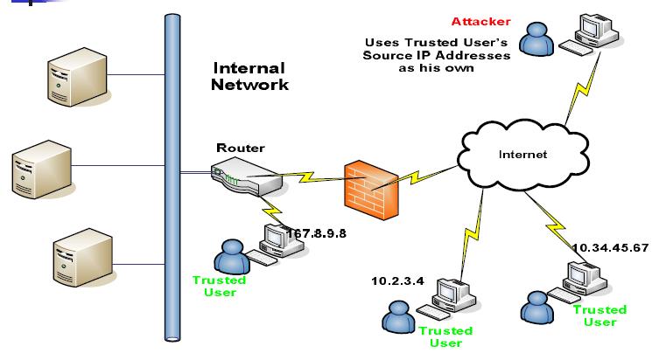
IP Spoofing
Notes:
IP spoofing attack occurs when an attacker outside your network pretends to be a trusted user either by using an IP address that is within the range of IP addresses for your network or by using an authorized external IP address that you trust and to which you want to provide access to specified resources on your network. Should an attacker get access to your IPSec security parameters, that attacker can masquerade as the remote user authorized to connect to the corporate network.

Slide 34
Why IP Spoofing is easy?
Problem with the Routers.
Routers look at Destination addresses only.
Authentication based on Source addresses only.
To change source address field in IP header field is easy.

Slide 35
Types of Network Attacks?
Insider
Threat

Slide 36
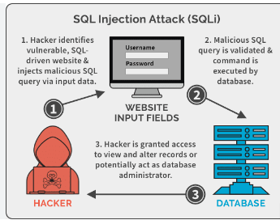
Common Types of Network Attacks
Code and SQL injection attacks
Many websites accept user inputs and fail to validate and sanitize those inputs. Attackers can then fill out a form or make an API call, passing malicious code instead of the expected data values. The code is executed on the server and allows attackers to compromise it.

Slide 37
Types of Network Attacks?
Insider
Threat

Slide 38
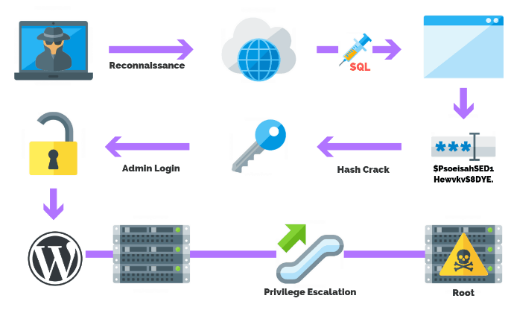
Common Types of Network Attacks
Privilege escalation
  Once attackers penetrate your network, they can use privilege escalation to expand their reach.
  Horizontal privilege escalation involves attackers gaining access to additional, adjacent systems and
  Vertical escalation means attackers gain higher privileges for the same systems.
  A cyberattack to gain illicit access to elevated rights, permissions, entitlements, or privileges beyond what is assigned for an identity, account, user, or machine. This attack can involve an external threat actor or an insider threat.
https://purplesec.us/resources/cyber-security-statistics/#Recent

Slide 39
Types of Network Attacks?
Insider
Threat

Slide 40
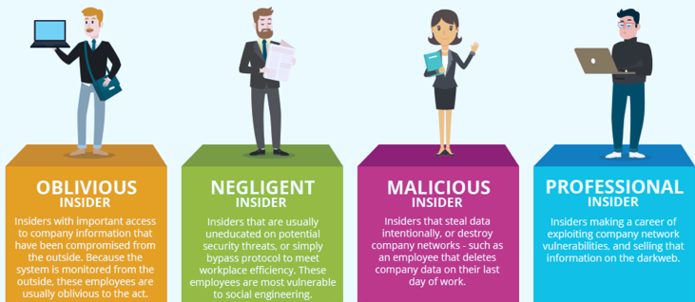
Common Types of Network Attacks
Insider threats
A network is especially vulnerable to malicious insiders, who already have privileged access to organizational systems. Insider threats can be difficult to detect and protect against because insiders do not need to penetrate the network to harm. New technologies like User and Even Behavioral Analytics (UEBA) can help identify suspicious or anomalous behavior by internal users, which can help identify insider attacks.

Slide 41
Common Types of Network Attacks
How to mitigate the risk of insider threats
Conduct regular risk assessments to understand the potential impact of insider attacks
Provide regular security awareness training for all staff
Closely manage the accounts and privileges of all employees and contractors
Implement 24/7 network and endpoint monitoring to detect anomalous behavior
Perform penetration testing at least annually to help identify security improvements

Slide 42
Network Protection Best Practices
Regulate Access to the Internet via Proxy Server
Place Security Devices Correctly
Use Network Address Translation
Monitor Network Traffic
Use Deception Technology
Segregate Your Network

Slide 43
Deception technology?
Deception technology is a cybersecurity approach that involves creating traps or decoys to mislead and detect attackers within a network or system. The goal is proactively identifying and thwart potential threats by confusing and diverting attackers away from real assets. Deception technology includes deploying fake servers, networks, or data resources that appear genuine but are designed to lure and expose malicious actors.
Key aspects of deception technology:
Decoys: Fake systems, files, or networks are strategically placed within an organization's infrastructure to deceive attackers.
Traps: Deceptive elements are set up to trigger alerts or responses when accessed or tampered with, providing early warnings of potential cyber threats.
Detection: By closely monitoring and analyzing the interactions with the decoys, security teams can identify abnormal behavior indicative of an unauthorized presence or malicious activity.

Slide 44
Deception technology?
Benefits of deception technology:
Early Detection: Provides an early warning system, enabling security teams to detect threats in the early stages of an attack.
False Positives Reduction: Helps reduce false positives by focusing on unauthorized interactions with deceptive elements.
Incident Response Improvement: Enhances incident response capabilities by providing insights into an attacker's tactics, techniques, and procedures.
Deception technology is part of a comprehensive cybersecurity strategy, complementing other security measures like firewalls, antivirus software, and intrusion detection systems.
Honeypots

Slide 45
Network Protection Best Practices
Regulate Access to the Internet via Proxy Server
Do not allow network users to access the Internet unchecked. Pass all requests through a transparent proxy, and use it to control and monitor user behavior. Ensure that outbound connections are actually performed by a human and not a bot or other automated mechanism. Whitelist domains to ensure corporate users can only access websites you have explicitly approved
Place Security Devices Correctly
Place a firewall at every junction of network zones, not just at the network edge. If you can’t deploy full-fledged firewalls everywhere, use the built-in firewall functionality of your switches and routers.

Slide 46
Network Protection Best Practices
Use Deception Technology
No network protection measures are 100% successful, and attackers will eventually succeed in penetrating your network. Recognize this and place deception technology in place, which creates decoys across your network, tempting attackers to “attack” them, and letting us observe their plans and techniques. You can use decoys to detect threats in all stages of the attack lifecycle: data files, credentials ad network connections
Segregate Your Network
A basic part of avoiding network security threats is dividing a network into zones based on security requirements. This can be done using subnets within the same network or by creating Virtual Local Area Networks (VLANs), each behaving like a completely separate network. Segmentation limits the potential impact of an attack to one zone and requires attackers to take special measures to penetrate and gain access to other network zones

Slide 47
Network Protection Best Practices
Use Network Address Translation
Network Address Translation (NAT) lets us translate internal IP addresses into addresses accessible on public networks. we can use it to connect multiple computers to the Internet using a single IP address. This provides an extra layer of security, because any inbound or outgoing traffic has to go through a NAT device, and there are fewer IP addresses which makes it difficult for attackers to understand which host they are connecting to
Monitor Network Traffic
Ensure we have complete visibility of incoming, outgoing and internal network traffic, with the ability to automatically detect threats, and understand their context and impact. Combine data from different security tools to get a clear picture of what is happening on the network, recognizing that many attacks span multiple IT systems, user accounts and threat vectors

Slide 48
As power electronics comes online, cyber-attack risk increases
Power Electronics manage every aspect of our life, e.g., in our homes, cars, factories, etc.,
As IoT technology drives these devices online, they become more visible, controllable, and efficient, which at the same time makes them cyber security risk
Case Study :
In April 2021, two attackers hacked into a Tesla remotely; they used a drone with WiFi, which could attack a parked car from 100m
The attack exploits two vulnerabilities affecting the internet connection manager for embedded device
This exploitation allows hackers to appear as regular users of the infotainment system, such as opening the door, changing seat position, playing music, etc, but can’t yield driver control of the car.
Fortunately, this attack was performed by ‘white hat’ researchers participating in the Pwn2OWN 2020 hacking competition.
However, according to an Automotive cybersecurity report, the frequency of cyberattacks on cars increased by 225% from 2018 to 2021; nearly 85% of attacks in 2021 were carried out remotely.

Slide 49
Thanks!

